Slide 1
American Sign Language Interpreter
By Natalie King, Jinho Lee, Domingo Viesca, Sylvie Watts

Slide 2
Traditional CV Approaches
vs. CNN?
Our main research objective was seeing whether traditional CV approaches (e.g SVM) or CNN’s were more accurate at identifying letters/phrases in ASL.

Slide 3
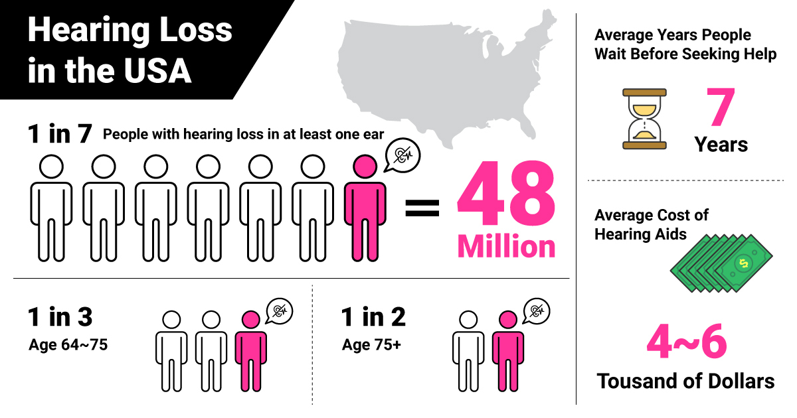

Slide 4
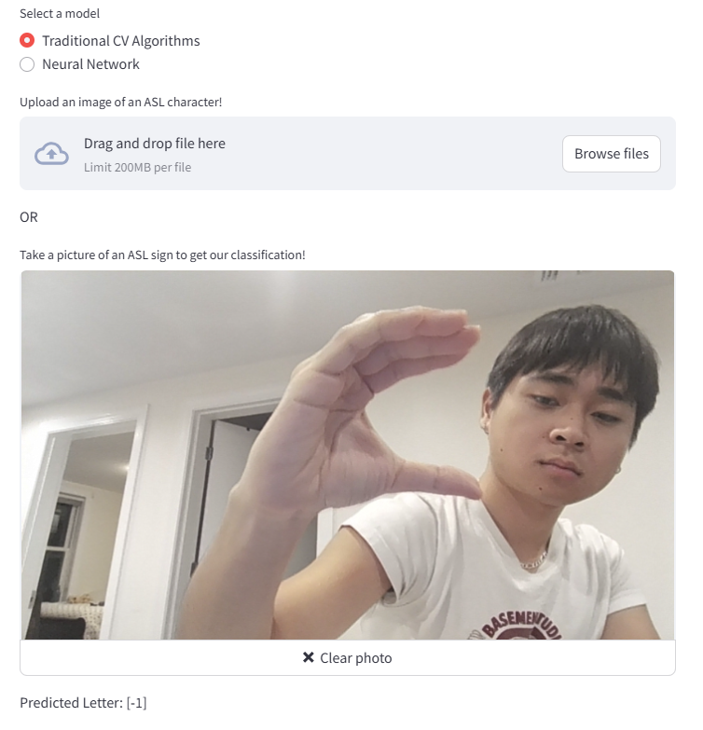
Our app:
How it works:
Built using streamlit and Python.
The model is trained off of the ASL Alphabet Dataset in Kaggle.
The training data set contains 87,000 images which are 200x200 pixels.
There are 28 classes, of which 26 are for the letters A-Z and 2 classes for SPACE and NOTHING.
We cut the data to 40 images per class, which results in lower accuracies, but faster runtimes.
Notes:
we made a web interface to make it easy to capture an image and see what the predicted letter is in realtime.

Slide 5
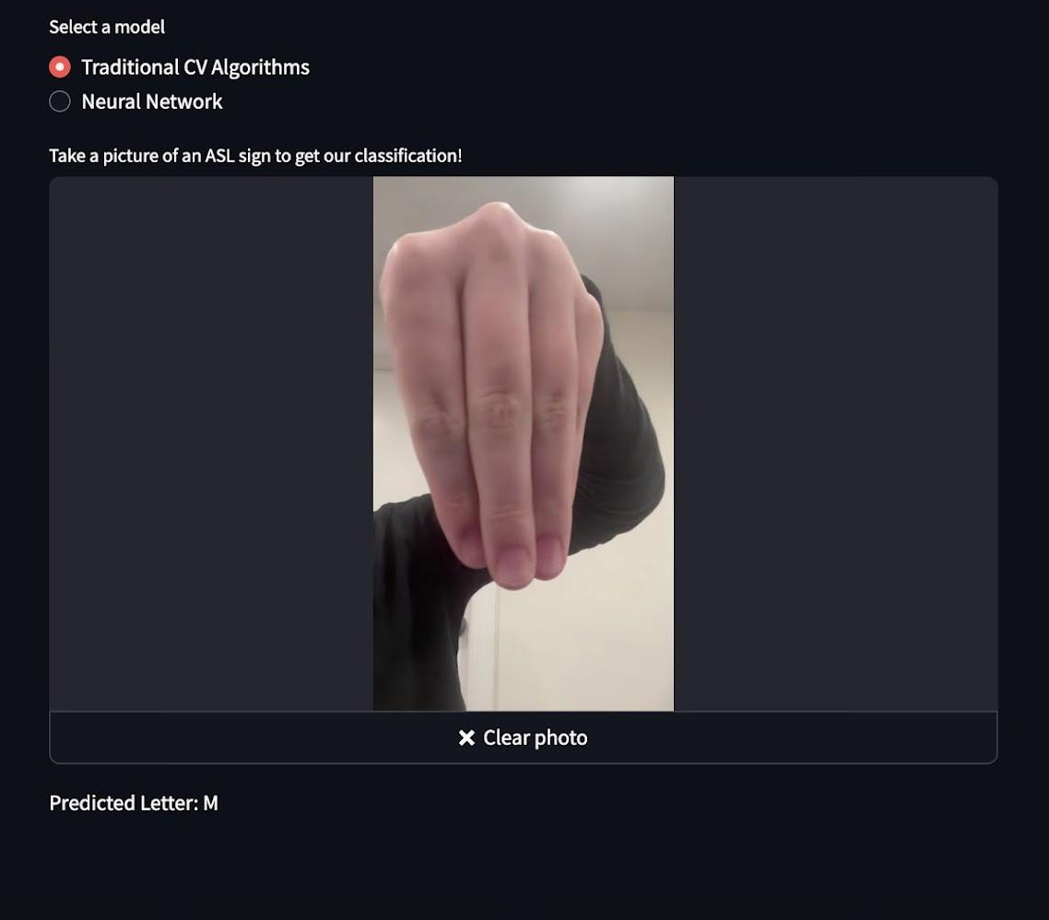
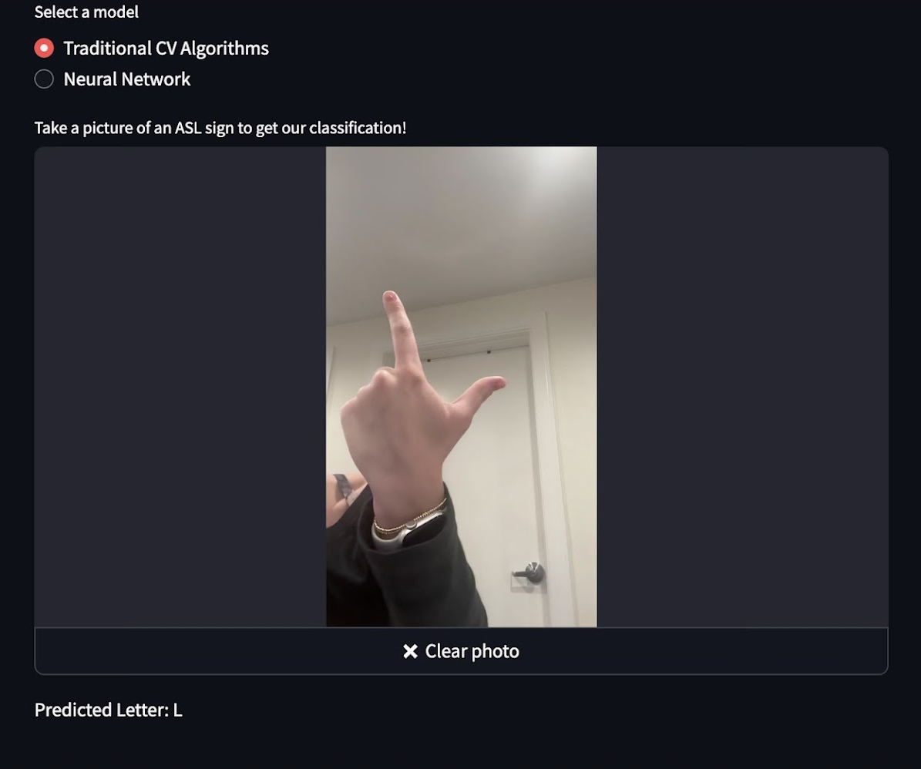
Our app:

Slide 6
Pretrained vs Custom CNN
Pretrained is a fine-tuned version ResNet-18, a CNN with 18 layers used for image classification for over 1,000 categories and trained on a large database. Custom CNN is our own network trained ground up on our own model.
Notes:
-custom CNN - we replaced the final layer to have a linear layer that goes to our 28 classifications (instead of 1,000 as it would normally)
-takes advantage of the already learned patterns, uses those patterns for ASL signs

Slide 7
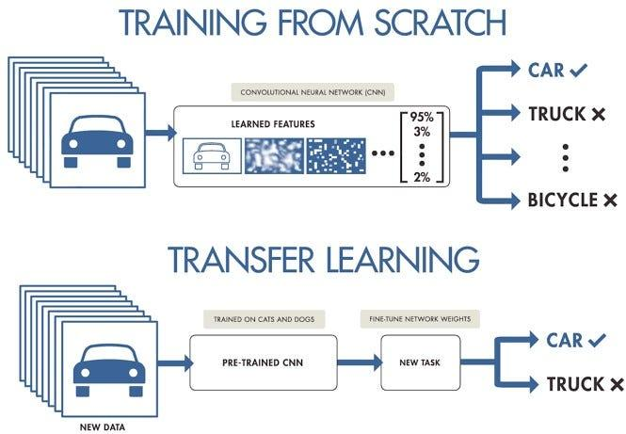
x
Notes:
we made a web interface to make it easy to capture an image and see what the predicted letter is in realtime.

Slide 8
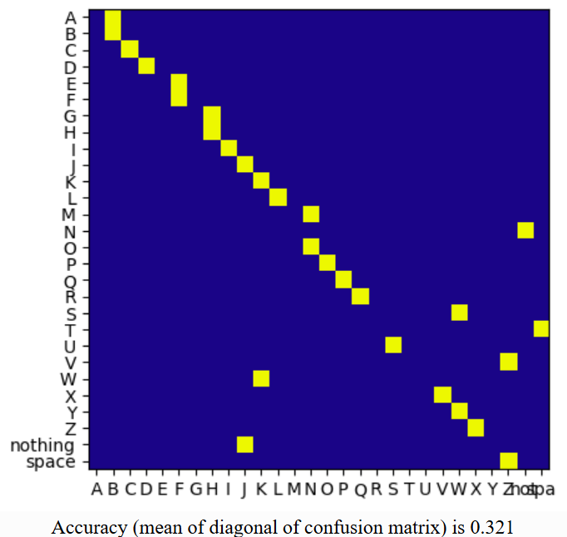
OUR FINDINGS
SIFT (Using Linear SVC) | CNN Pretrained Model | CNN Custom Model | OTHER KERNELS WITH SIFT
 | Highest Train Accuracy: 87.86% Validation Accuracy: 69.48% | Highest Train Accuracy: 100% Validation Accuracy: 51.62% | RBF: 39.29% Sigmoid: 21.43% Polynomial: 85.7%
32.1% | ~87.9% | ~100% | 21.43% - 85.7%
Notes:
-this CNN model accuracy is with just 11 testing image for each classification - adding more data and retraining, overfitting on custom model

Slide 9
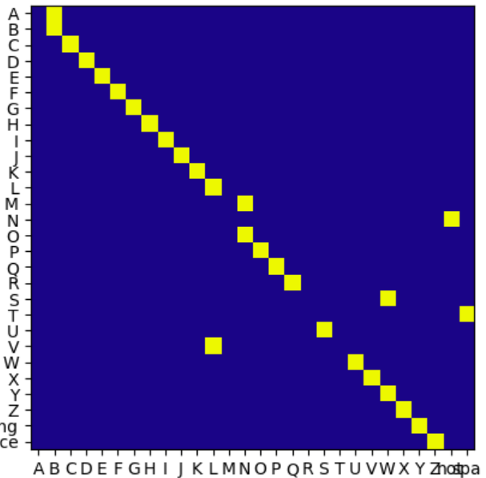
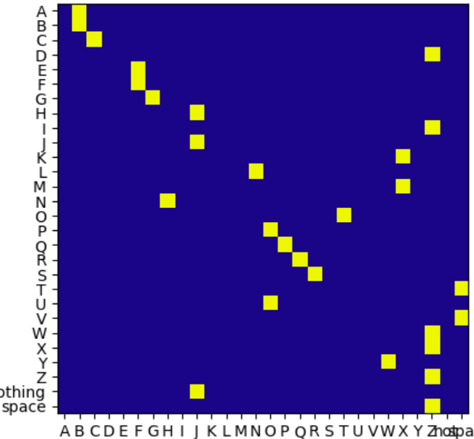
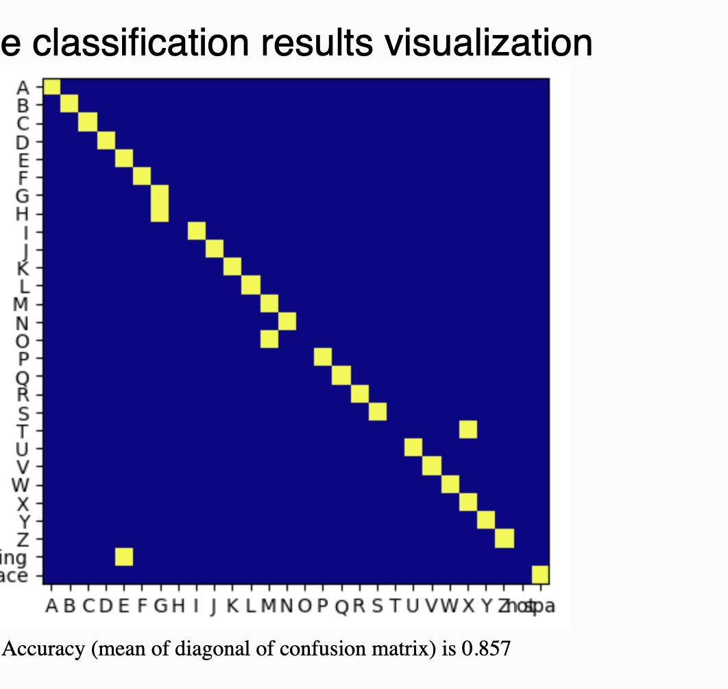
More findings: Changing the Kernel
LINEAR SVC
RBF
SIGMOID
POLYNOMIAL

Slide 10
THANKS!
:)

